Slide 1

Jigsaw: Large Language Models meet Program Synthesis
Team : GOAT
Names: Sami Shahade
Mohammad Sharif

Slide 2

Introduction
PTLM
Multi-modal Inputs
Program Synthesis
Jigsaw

Slide 3

Motivation and Problem Statement
Motivation: As we mentioned earlier, PTLM, like GPT-3, has shown great potential in generating code from natural language descriptions, which can significantly improve programmer productivity.
Problem: These models treat code as text and do not understand the underlying syntax or semantics, which can misinterpret variable names or use incorrect arguments for functions. This leads to bugs and often results in incorrect or low quality code.

Slide 4

Proposed Solution
To solve this problem, the researchers created Jigsaw, a system that helps create better code. Jigsaw accepts both natural language descriptions and test cases as input.
It has three main parts: pre-processing, integration of PTLM and post-processing.

Slide 5
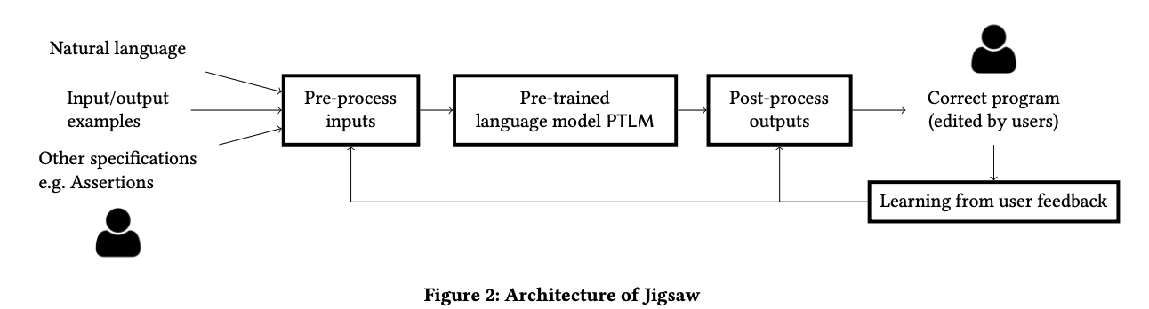
Jigsaw Architecture

Slide 6
Datasets
PandasEval1
This dataset consists of 68 Python Pandas tasks, each of which can be solved with a single line of code using 2-3 Pandas functions. It was created from queries found on forums like StackOverflow to test Jigsaw's effectiveness in solving real-world coding problems.
PandasEval2
This dataset includes 21 Pandas tasks, which can be solved with 2-3 Pandas functions. It was created during the hackathon with 25 users writing 725 unique natural language queries, testing Jigsaw's ability to interpret and respond to diverse user input.

Slide 7
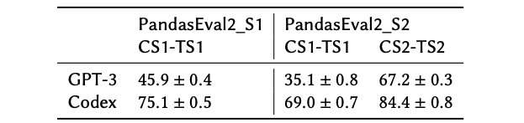
Temporal evaluation
Test Jigsaw's ability to learn from user feedback using tasks from the two hackathon sessions. After updating the context and its transformation rules from the first session, Jigsaw's performance greatly improved in the second session. For example, GPT-3's accuracy increased by over 30%, and Codex improved by 15%. This shows that Jigsaw improves with more user interaction, making it more accurate and useful over time.

Slide 8
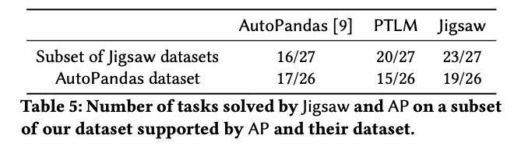
Comparison to AutoPandas
AutoPandas (AP) generates Pandas programs using examples of input and output data, but it struggles with more complex tasks. We tested Jigsaw, which uses both natural language and input-output examples, on 27 tasks that AP can handle. Jigsaw did better because it can understand tasks more clearly. We also tested Jigsaw on another dataset from StackOverflow, and Jigsaw (with Codex) performed better than AP.

Slide 9

Future Work and Conclusions
Conclusions:
The biggest improvement that Jigsaw brings is in the post-processing steps, which make the generated code much better.
Jigsaw does better than methods that use only language models or only input-output examples.
Jigsaw is the first tool to generate code for large APIs like Pandas using advanced language models like GPT-3.
Future Work:
There are still some challenges to making Jigsaw a perfect coding assistant. Currently, the quality of Jigsaw's code depends mostly on I/O examples, but real code should be fast and secure.
Jigsaw uses natural language and examples to figure out what code to write, but sometimes those instructions aren't clear enough. It needs more detailed instructions to get the best results.

Slide 10

Q&A thank you ☺

Slide 11

Class Activity
Given 3 Python functions with errors, you are asked to write a prompt to PTLM with input/output examples and your goal is to get correct code without errors (which currently exist)

Slide 12
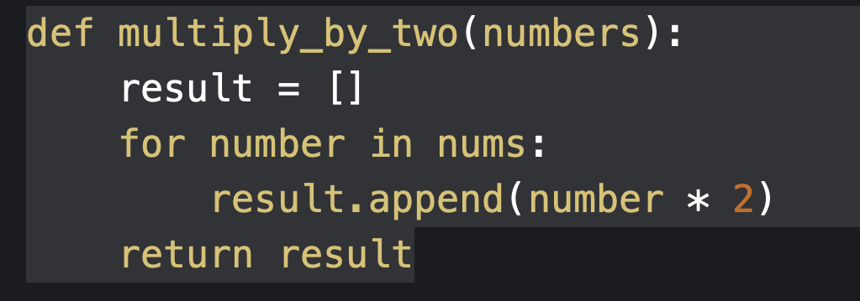
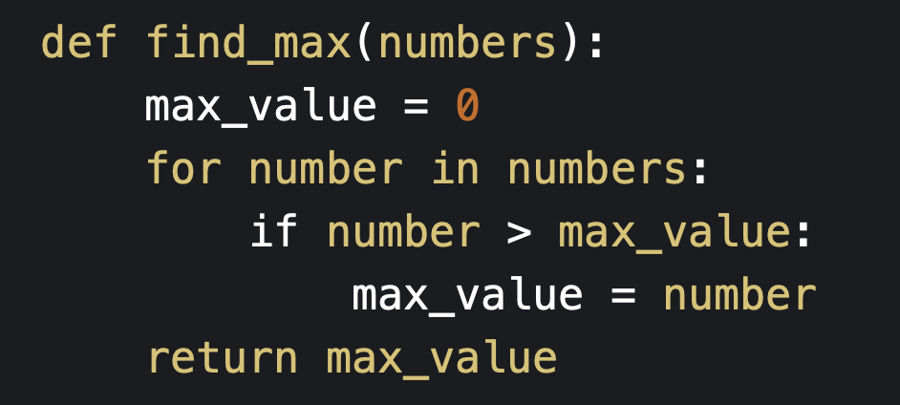
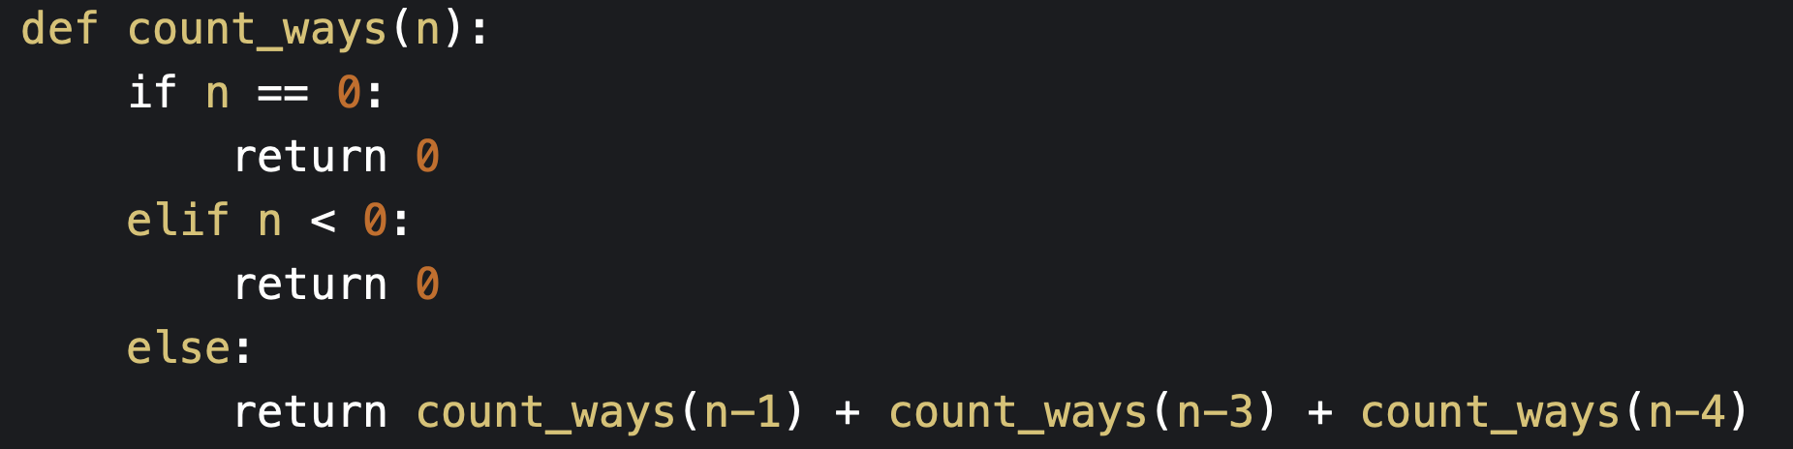
Codes :

